Slide 1
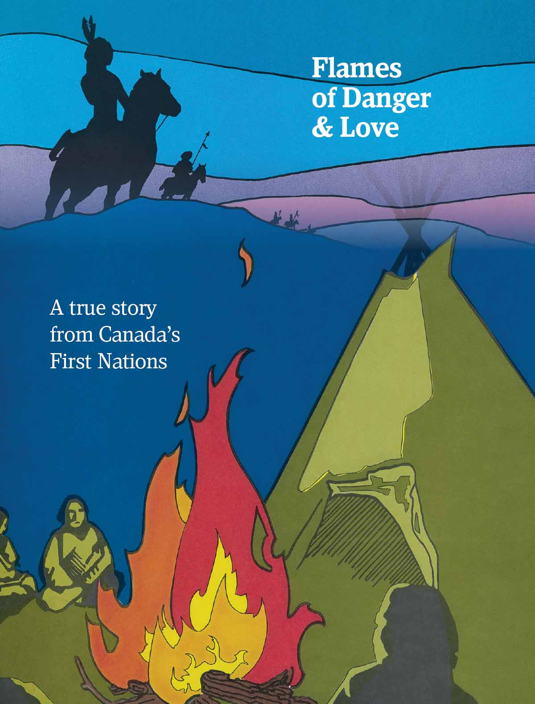
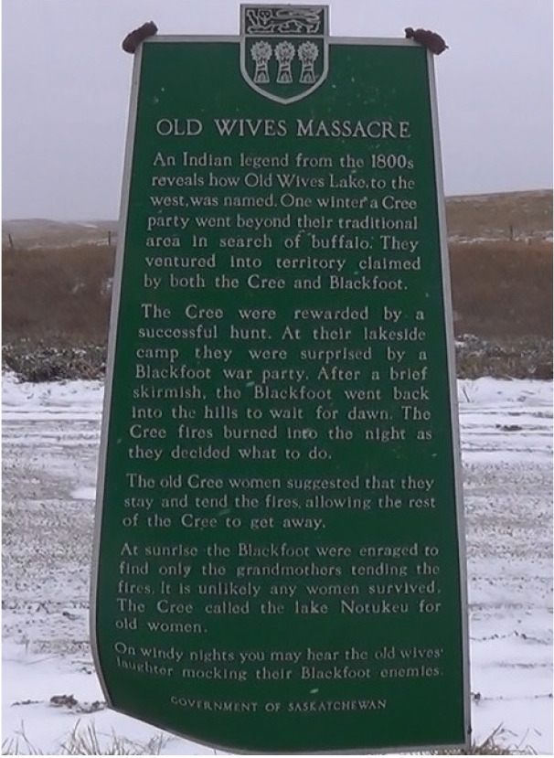
Notes:
Flames of Danger & Love
Is a true story from Canada’s First Nations.
This is the amazing story of how a band of grandmothers saved their families. It is believed to have taken place in the early 1840s, and told to the first officers of the North West Mounted Police by their Metis guides on their Great March West.
(picture on the right) This historic marker is located southwest of Moose Jaw, Saskatchewan, beside what became known as Old Wives Lake – in honour of these heroic Cree grandmothers.
Adapted from Of Love & Danger written by Martha Tarry. Illustrated by Louise (Olson) Jones. Copyright ©2025, Tribal Trails Books & Resources, a department of NCEM. Thanks to Claire Witherow for cover & page design, production assistance.

Slide 2
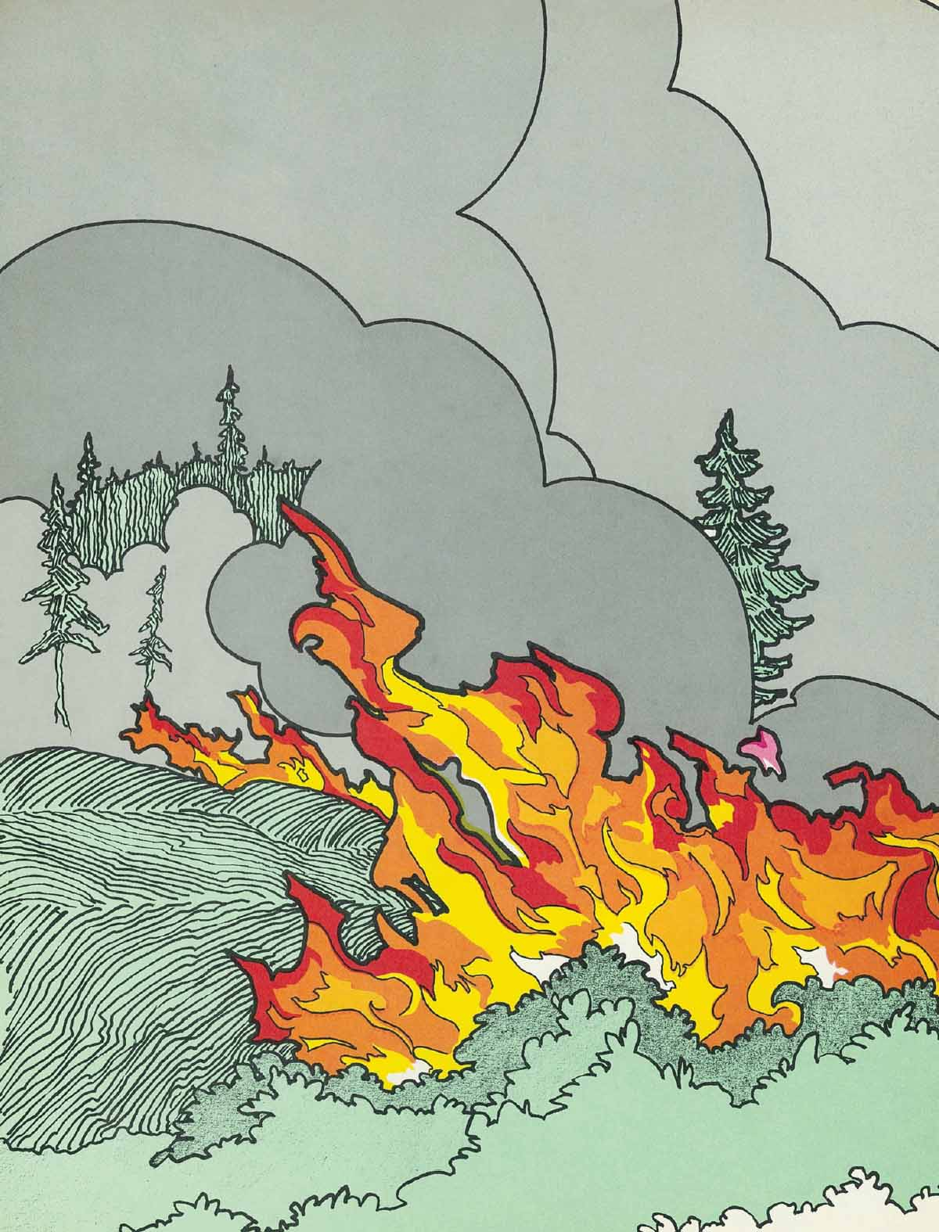
Notes:
Fire! Fire! Fire!” The message went from one tipi to the next tipi, to the next. A big fire was sweeping across the plains and through the valley – burning grass, bushes and trees. For several days the fire burned, scaring away many animals, and trapping some in the flames.
The band of Cree people were camped in a safe place. But as their chief looked over the large burnt area, he had great concern for his people. What would they do now? Their lives depended on the berries and the animals.
Now everything was burnt black. There were no berries and no animals. The big buffalo from which they got most of their meat were gone! No doubt they had run ahead of the fire.

Slide 3
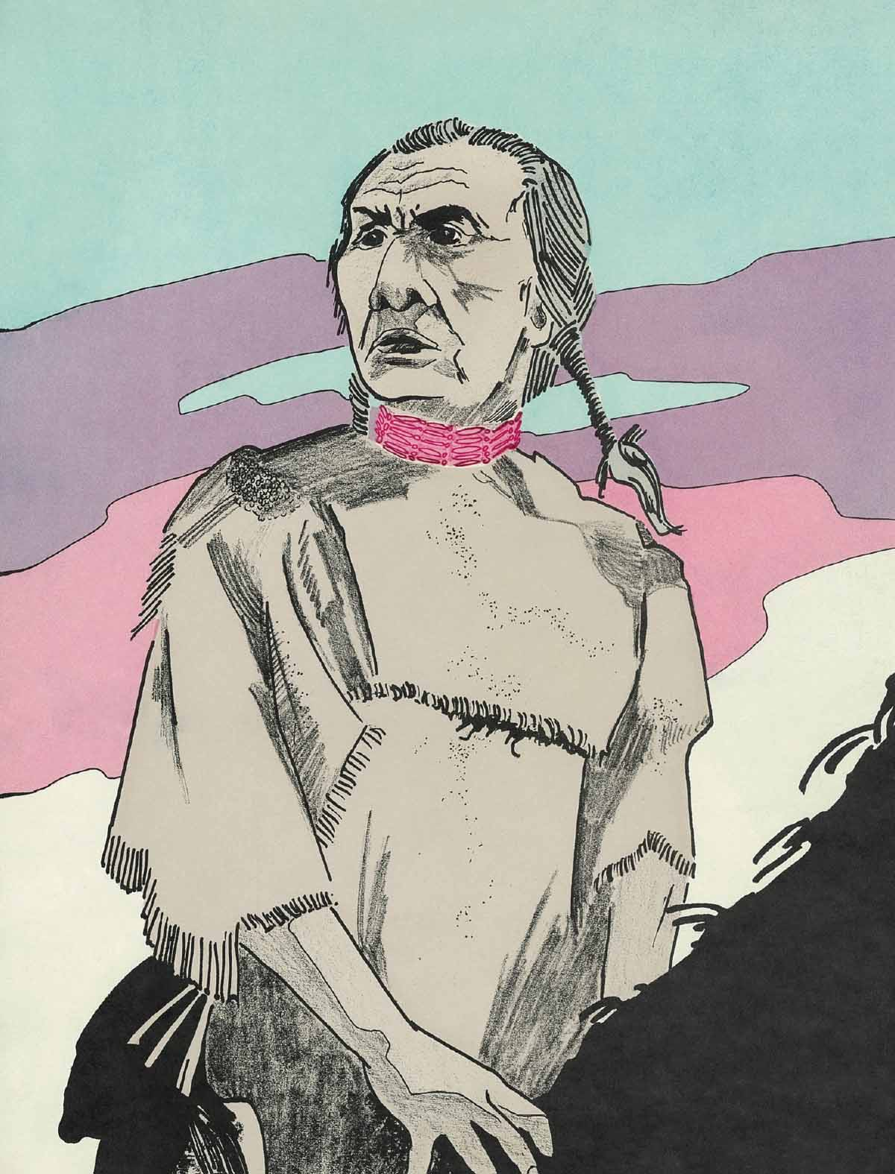
Notes:
Quickly the chief called his men to a council meeting to decide what they should do. “Men,” he said, “There are no berries! No animals! No deer or buffalo! If we stay here we will starve to death. “We will have to pack up and see if we can find some buffalo. They most likely ran to the west, ahead of the fire. There is a lake west of here, and I think the buffalo will probably be there.” “But, Chief, we can’t go there,” replied one man. “We know that territory is controlled by our enemy. We know that if they see us taking buffalo on their territory, they will attack us. Then, Chief, many of our people will be killed!” “But men,” said the chief, “If we stay here, we’ll die for sure because we’ll starve to death. Don’t you think it’s better to go? Maybe we can get some buffalo meat and get back before the enemy sees us.

Slide 4
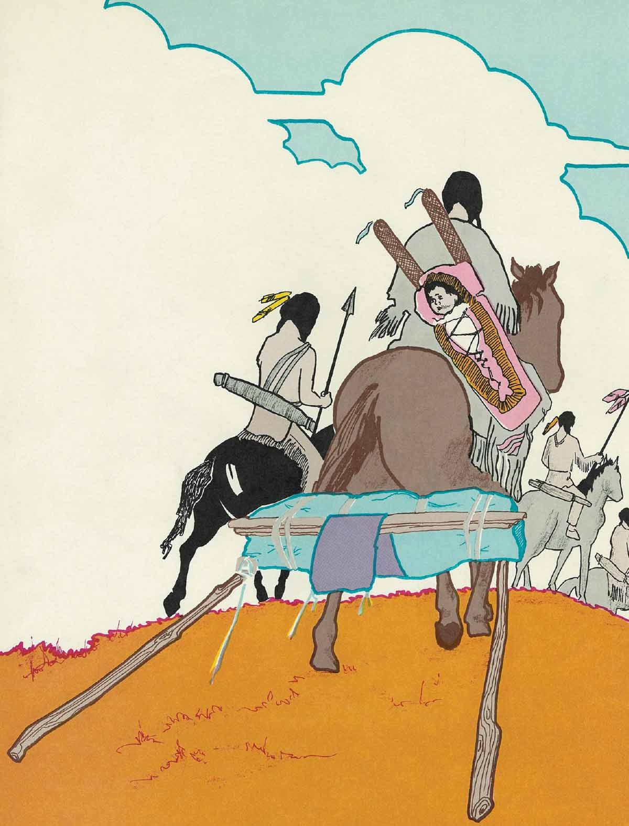
Notes:
Finally they decided that they would all have to go. Quickly they packed their tents and bedrolls, cooking pots, and the little bit of food they had. Soon moms and dads, grandfathers and grandmothers, and all the children were ready to go. No one stayed behind. Some carried their belongings on their backs. Some had a horse to haul their things. Soon they were all walking west, hoping they would soon find some buffalo. The further west they traveled, the closer they were getting to enemy country, and the more fear they felt. But these Cree people were desperate. They just had to find some buffalo, so on they went into enemy territory. Finally, they could see the lake in the distance and, sure enough, there were buffalo on the other side! They quickly set up their camp, and the hunters took off to get closer to the buffalo.

Slide 5
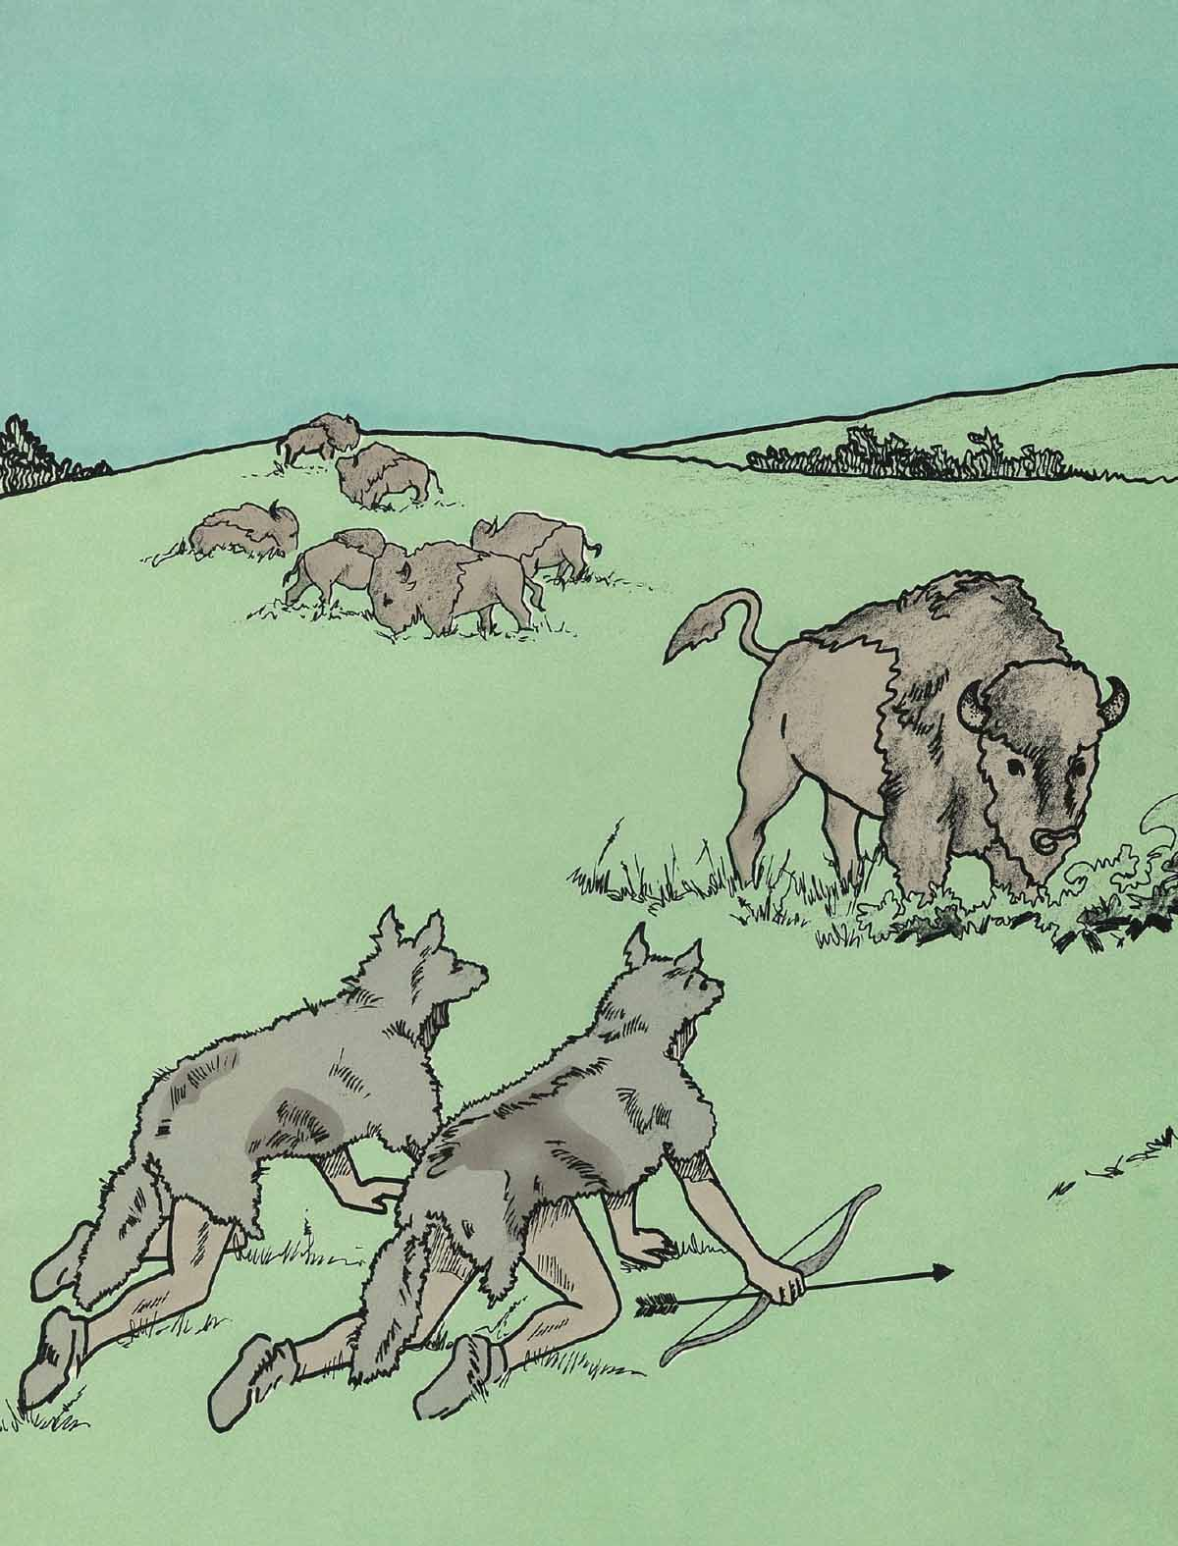
Notes:
Years of experience had taught them the best way to hunt buffalo. The best way was to fool the buffalo. They would put the skins of wolves or coyotes over them. They would crawl among the buffalo herd on their hands and knees to get a close aim with their bows and arrows.

Slide 6
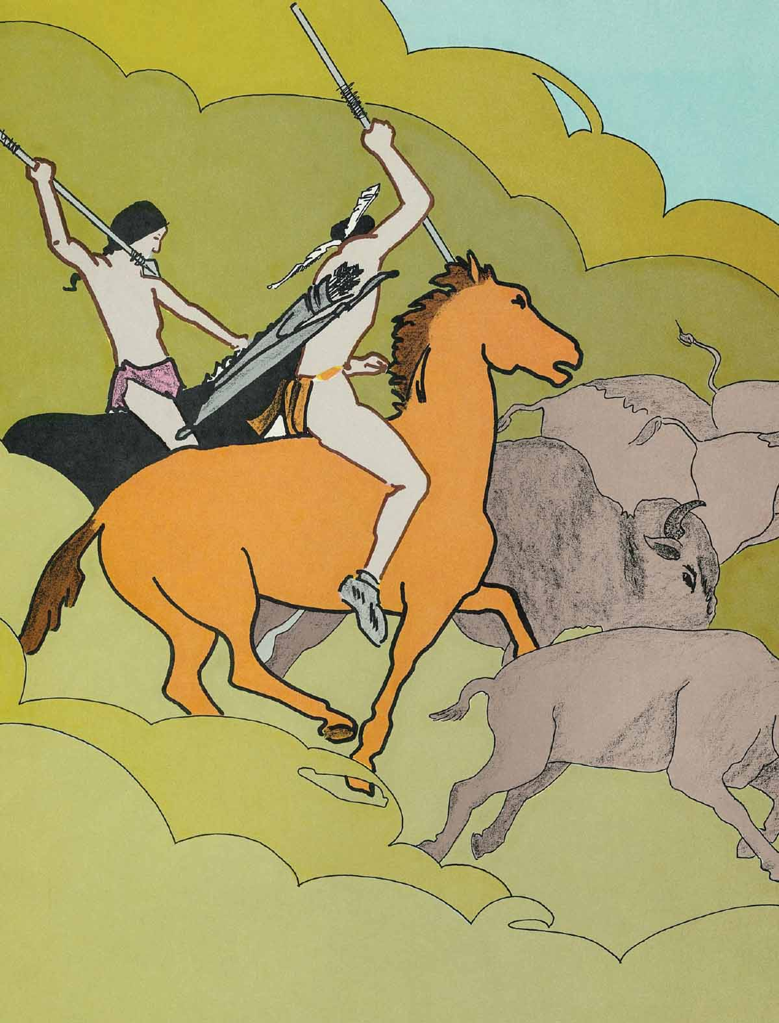
Notes:
Other hunters would rush in on their horses using spears. It wasn’t long before the Cree hunters had killed enough buffalo. As quickly as they could, they skinned the buffalo, and cut up the meat in pieces that could be carried back. Soon they had all the meat they could carry back home to their valley. Once again their tents and all their belongings were packed up. Then the long straggling line of old and young men and women with their children wound about the lakeside, moving back towards safety in their home territory.

Slide 7
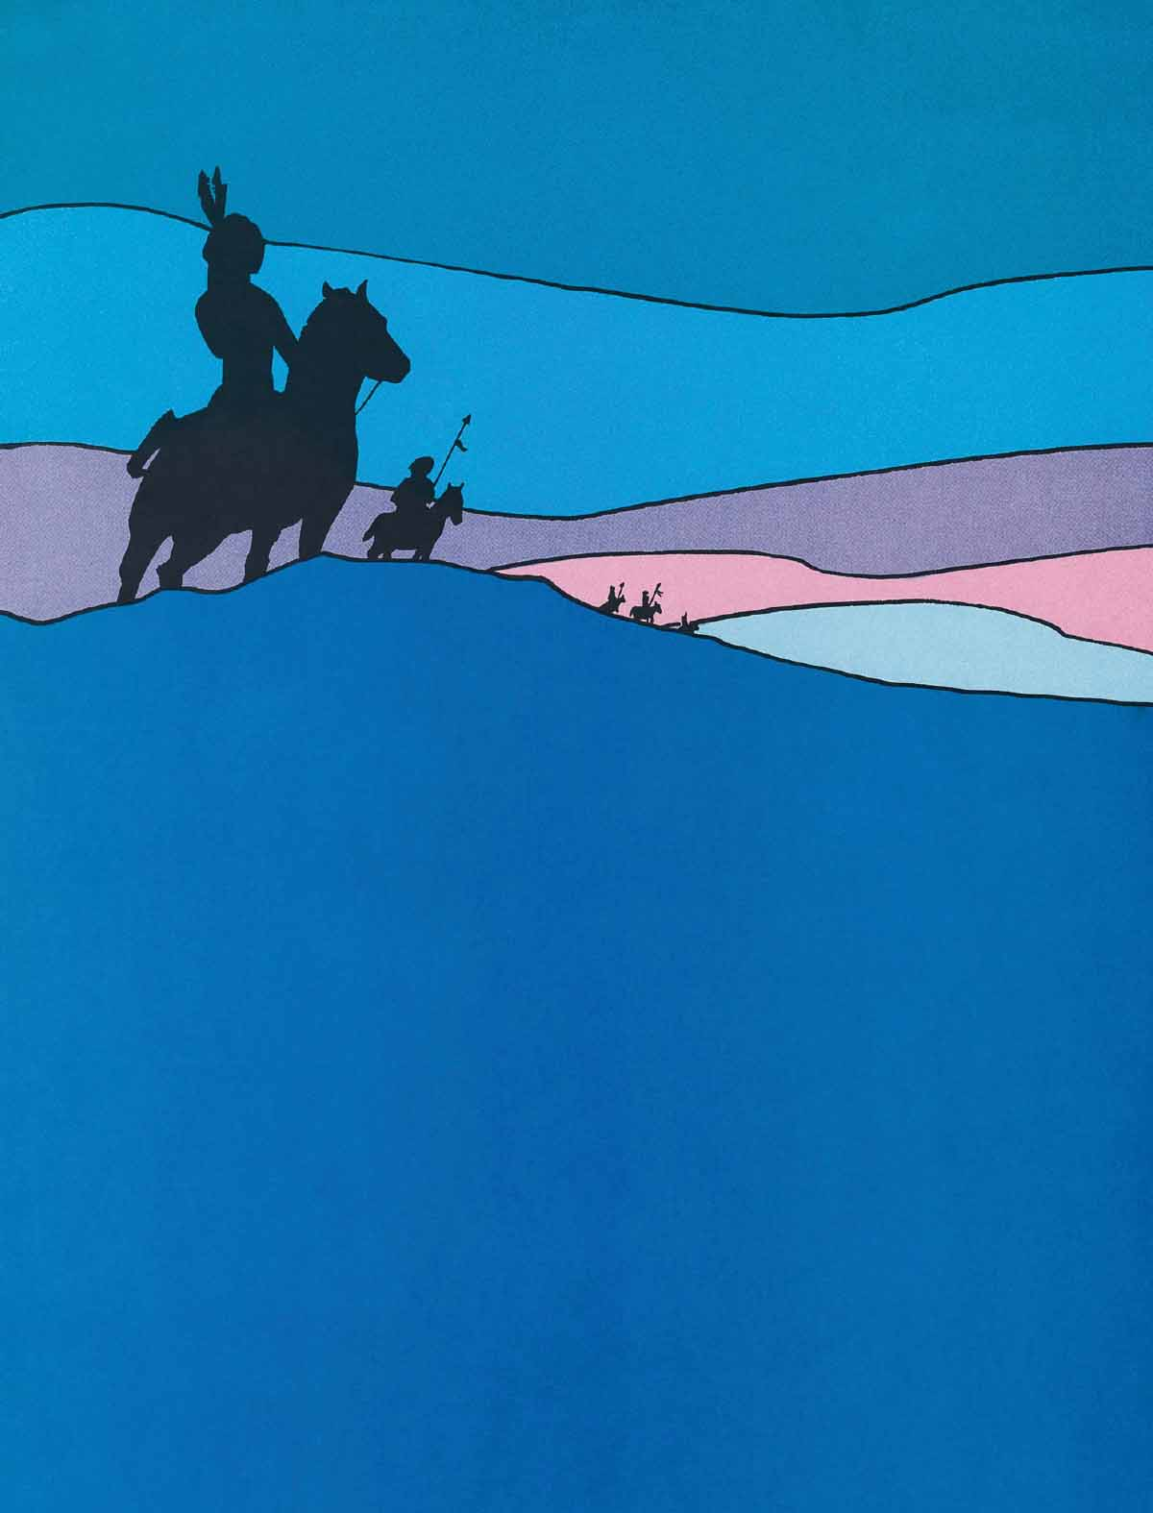
Notes:
Suddenly, someone saw men on horseback on top of the hills! “The enemy! The enemy! They have seen us!” Soon the word spread from one Cree family to another, and fear gripped their hearts. The Cree people tried to hurry, but they knew they could never get away from the enemy warriors on their fast horses. Quickly the Cree people put their women, children and old men in the center. On the outside edge were the Cree men with their bows and arrows, getting ready to fight off the enemy warriors.

Slide 8
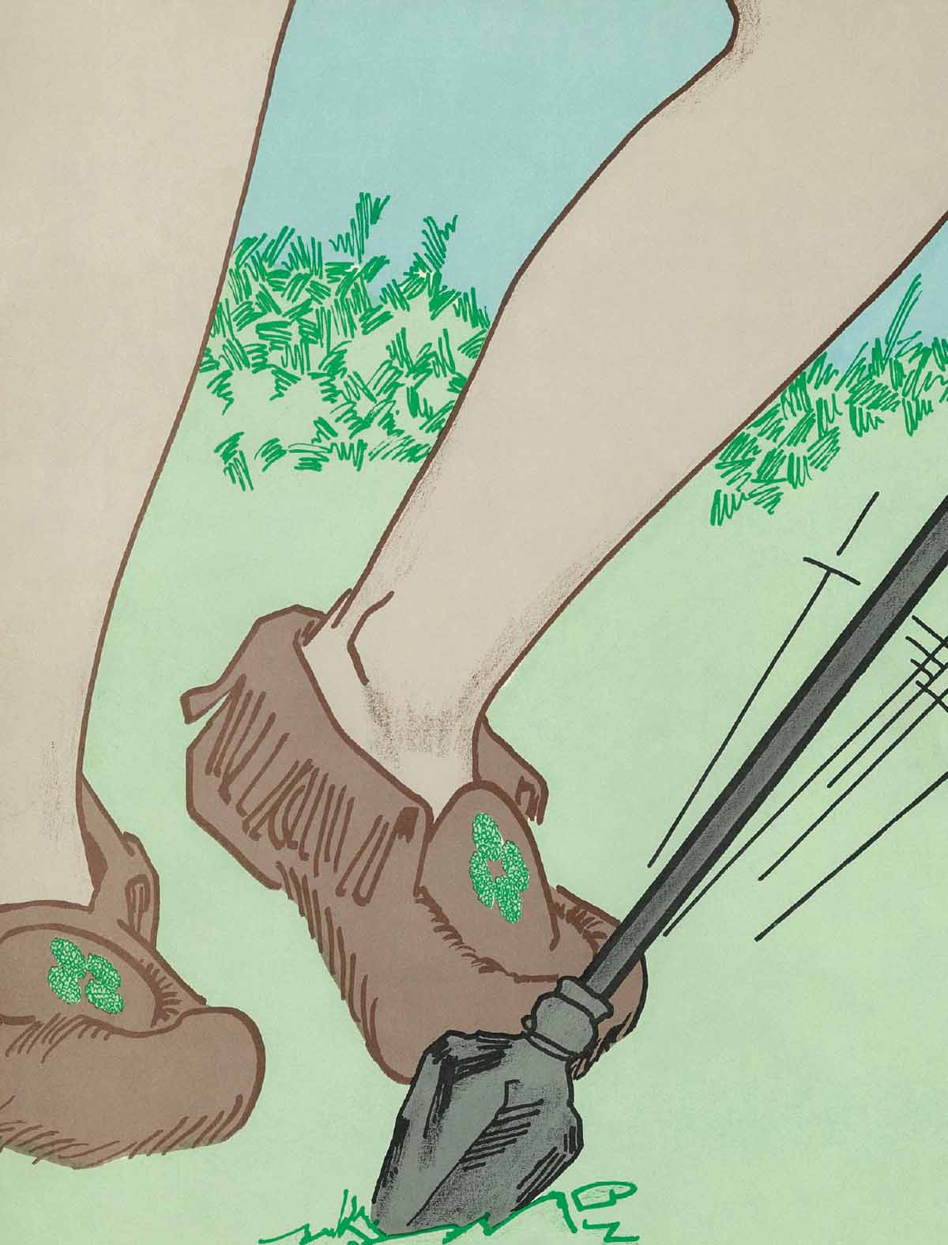
Notes:
Soon they heard the pounding of horse hooves and the war cries of their enemies. The enemy warriors circled around the Cree people, shouting and shooting arrows at them. But the Cree men fought back. Soon it was too dark to fight, and the enemy warriors disappeared back over the hills.

Slide 9
Notes:
Once again the Cree chief called his council together to decide what they should do. One Cree man had been killed and several were wounded. They knew that their enemy would return in the morning with more warriors. How could the Cree people – with women and children with them, and loaded down with food – ever hope to escape? This time not even the chief or any of the council had an idea about what to do next. They just sat there in silence.

Slide 10
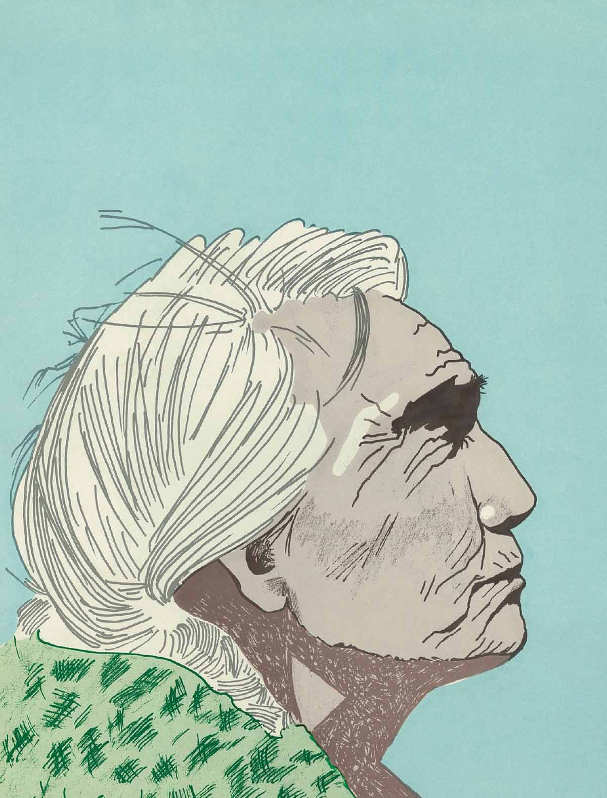
Notes:
As the men sat there, an old Cree grandmother walked over to them and said, “We old women have had a meeting of our own, and we have a plan. This is our plan ... Set up camp. Do it right away, so the enemy watching from the hilltop can see our tipis. “The enemy will probably attack when the sun comes up. We old women will keep fires burning all night. You men, take everyone else and hurry away in the dark. If you travel all night, by morning you will be far away, safely back in Cree country!” The men said, “But what will happen to you? The enemy warriors will likely kill you!” “Go, please go,” pleaded the older women. “It is better that we grandmothers die than all of our people be killed or captured.”

Slide 11
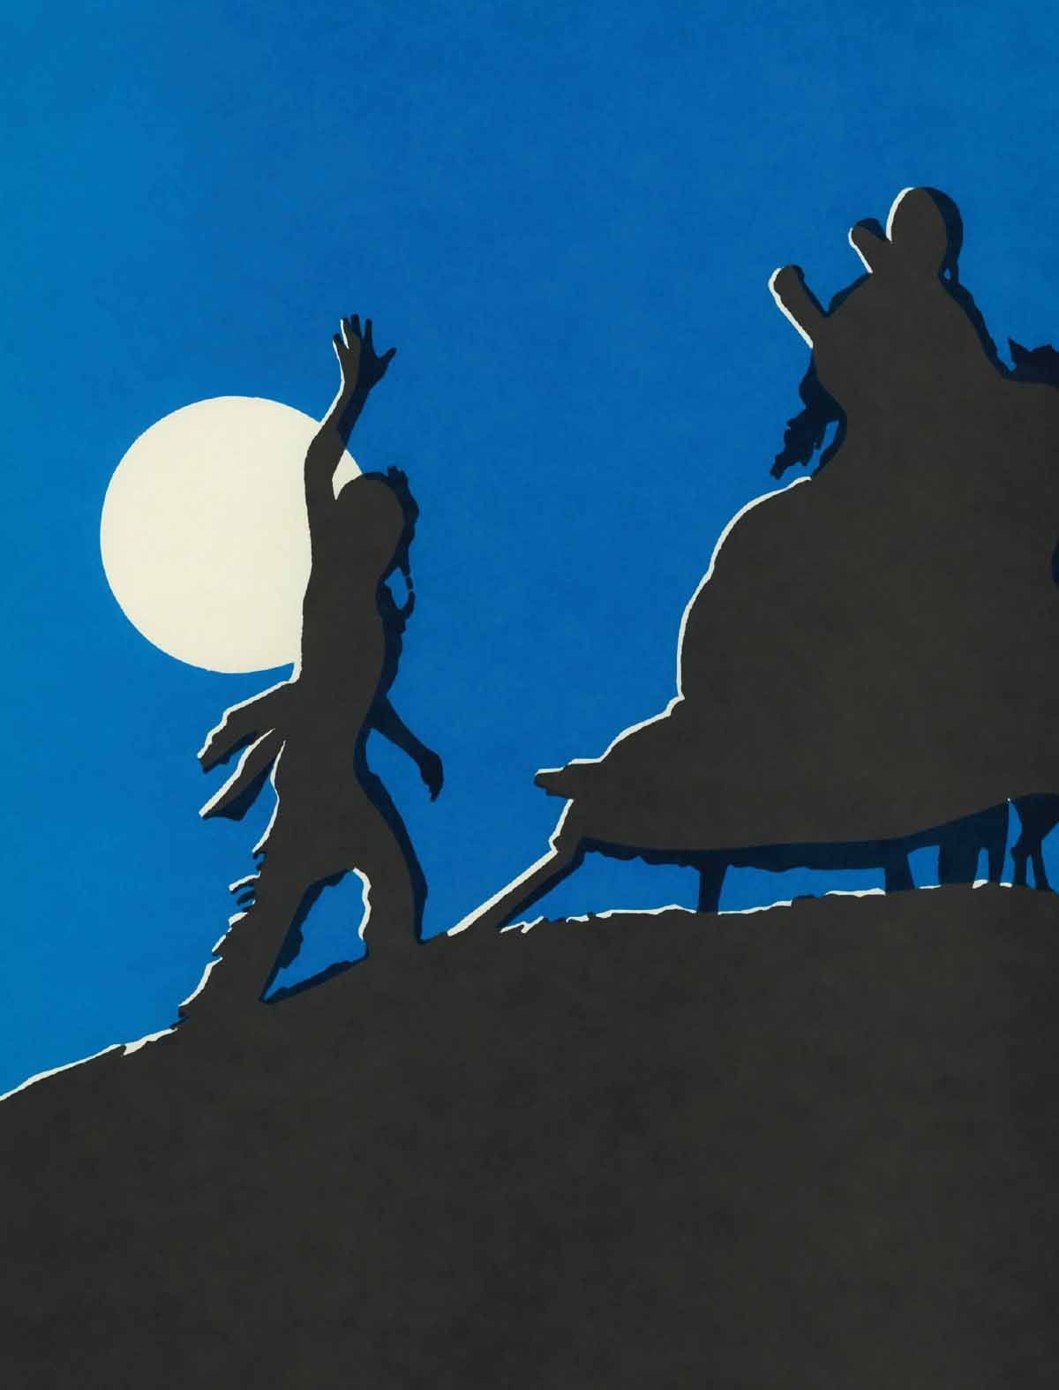
Notes:
Quickly the men set up some tipis. The few enemy warriors on the top of the hills kept their eyes on the Cree camp. They were making plans to get even with the Cree people who had taken buffalo on their territory. The Cree people lit big fires which sent sparks of light flying into the sky. Then they tearfully said their goodbyes to their grandmothers who were left behind. It was with sad hearts full of fear that the Cree people quietly hurried towards home in the dark. Then the old women threw their blankets around their shoulders, and talked loudly on purpose, and kept the fires burning brightly all night long.

Slide 12
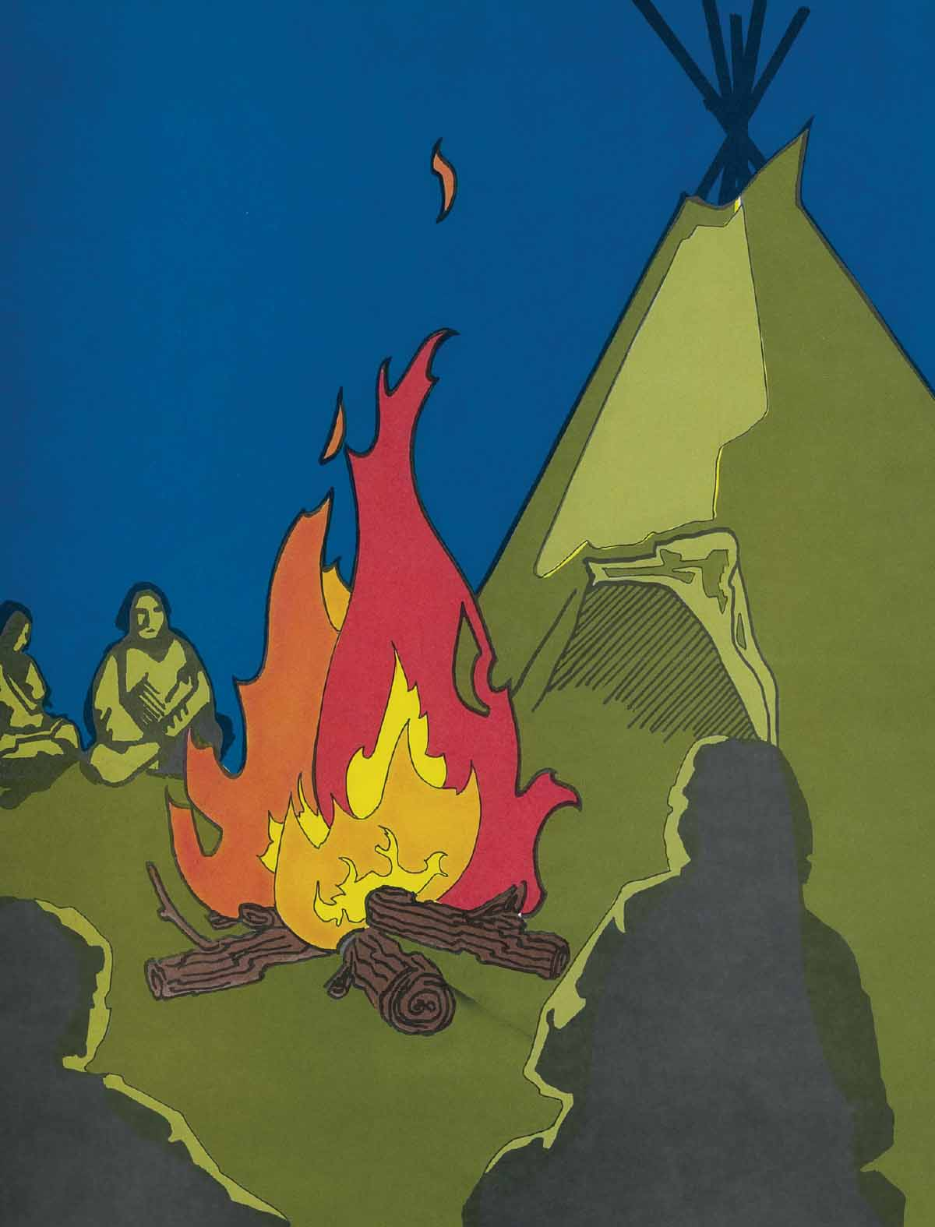
Notes:
Early the next morning the enemy warriors made their way to the Cree camp. The grandmothers’ hearts pounded with fear as they heard horse feet pounding the ground. Closer and closer they came. What would happen to them? And how about their sons, daughters and grandchildren? Would they be back safely in Cree country? Soon there were war cries from the enemy as they charged into the camp on their horses. To their surprise, all they saw were just a few old women wrapped in blankets sitting around the fires! “You fooled us! You tricked us!” they shouted in anger.

Slide 13
Notes:
Quickly the enemy warriors pulled out their bows and arrows and cruelly attacked the defenseless grandmothers. Sadly, it is not likely that any of them survived. What about the rest of the Cree people? ...Did they make it back to safety? These grandmothers loved their people so much that they were willing to die so that the rest might be saved. Did you know that someone loves you, and actually died for you so that you could live? Yes, our Creator did that! Jesus loves all people of the world so much that He died for us. We also have an enemy – his name is Satan. Satan would love to hurt and destroy us, but from the beginning God had a plan to save us from our enemy. Because of His great love for us, God made a plan for His Son Jesus to die on a cross so that we could escape death forever and go free. Our own wrong and selfish ways also put us in danger of death forever. Jesus said, “No one can have greater love than to give his life for his friends. You are My friends if you do what I tell you ... I am the Way and the Truth and the Life. No one can go to the Father except by Me” (from the Bible – John 15:13,14; 14:6). Yes, the Cree families had traveled all night and were safely back in their valley with much of their belongings and a good supply of food – a sad but good ending to this story. If you have questions, and are not able to talk with the person who gave you this booklet, we here at Tribal Trails are glad to have you call or write us. Phone 306-961-2588 anytime: Email: info@tribaltrails.org or visit our website: TribalTrails.org

